Slide 1

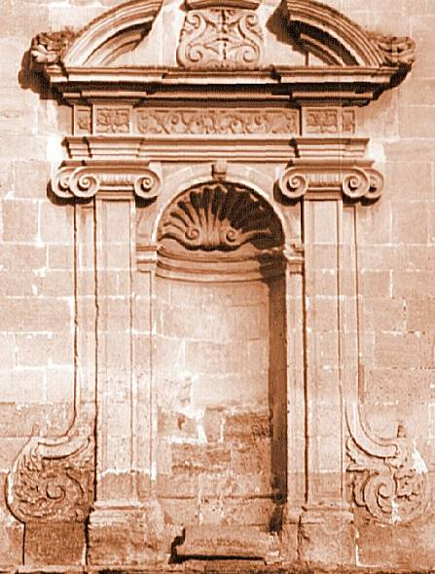
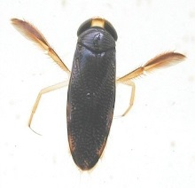
Metacommunities: Coexistence and Diversity

Slide 2
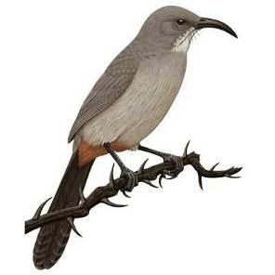
A Brief History of the (Ecological) Niche Concept
Grinnell (1917)→Hutchinson (1957)

Slide 3
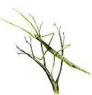


A Brief History of the (Ecological) Niche Concept
Niche
Factor Y
Factor Z
Factor X
Grinnell (1917)→Hutchinson (1957)

Slide 4

A Brief History of the (Ecological) Niche Concept
Niche
Factor Y
Factor Z
Factor X
Grinnell (1917)→Hutchinson (1957)

Slide 5
A Brief History of the (Ecological) Niche Concept
Niche
Factor Y
Factor Z
Factor X
Grinnell (1917)→Hutchinson (1957)

Slide 6
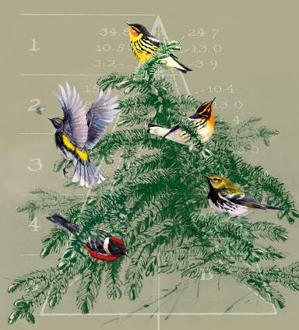
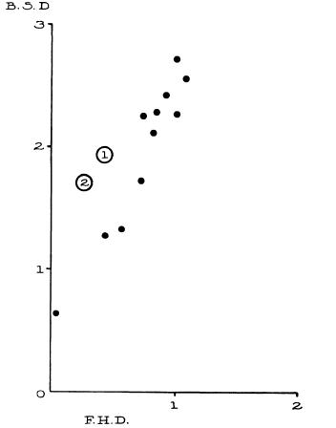
Ecological Niches as the Basis for Coexistence/Diversity
Bird Diversity
Foliage Height Diversity

Slide 7
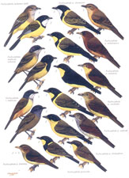
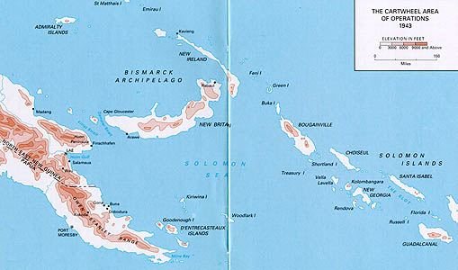
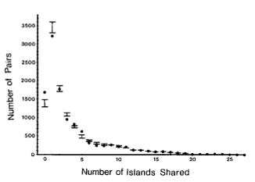
Diamond’s ‘Assembly Rules’

Slide 9
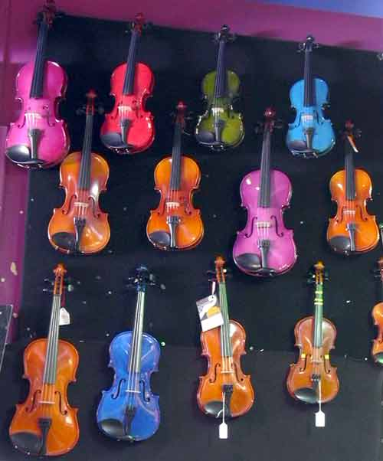
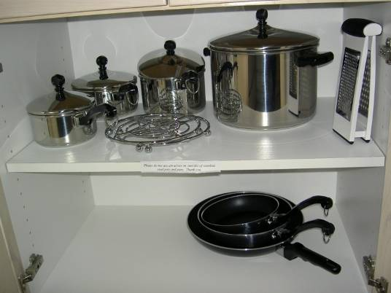
-D. Simberloff

Slide 10
Back to Square 1:
N_{t}=Population in the current time step
N_{t+1}=Population in the next time step (t +1)
B=# Births
I=# of Immigrants
D=# Deaths
E=# Emigrants
Present→ B>D
Absent→ B<D
(in a closed population)

Slide 11
Two species together…the species with the lowest R* always wins
….when there is only one limiting resource, and the system is at equilibrium
b₁
b₂
Per Capita growth
or loss rate
d₂
R₁*
R₂*
Resource Availability (R)
…A fundamental principle…the R* Rule
…But, then how do species coexist??

Slide 12
Fundamental Principle of Coexistence: Linked trade-offs
Resource Competition
Apparent Competition
Coexist
Resource A
Predator A
Coexist
Resource B
Predator B
Keystone Predation
Disturbance/variation
Predator
Disturbance/ E nv. variation
Coexist
Coexist
Resource
Resource
Chase and Leibold 2003

Slide 13
Species can’t be too similar……
….but, they also can’t be too different
Chesson’s (2000) General Theory of Coexistence
Coexistence depends on the ratios of:
→Stabilizing Mechanisms (Can’t be too similar)
→Equalizing Mechanisms (Can’t be too different)
Modern Coexistence Theory (MCT)
Possible Coexistence
Possible Coexistence
Resource A
Resource B

Slide 14
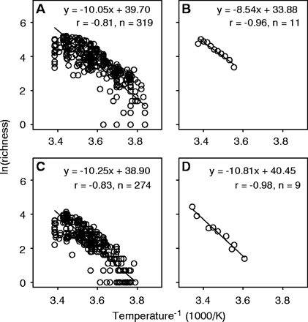
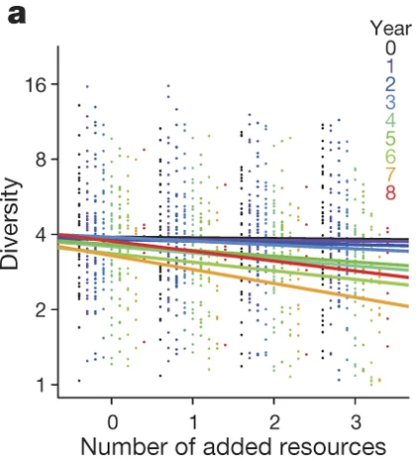
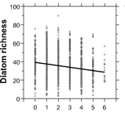
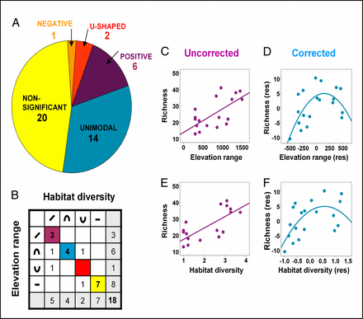
Niches at the forefront of biodiversity studies…..
Allen et al. 2002 Science
Harpole et al. 2016, Nature
Passey 2008 PNAS
Allouche et al. 2012 PNAS

Slide 15
Even classic coexistence stories had a spatial component
Gause 1934

Slide 16
Even classic coexistence stories had a spatial component

Slide 17
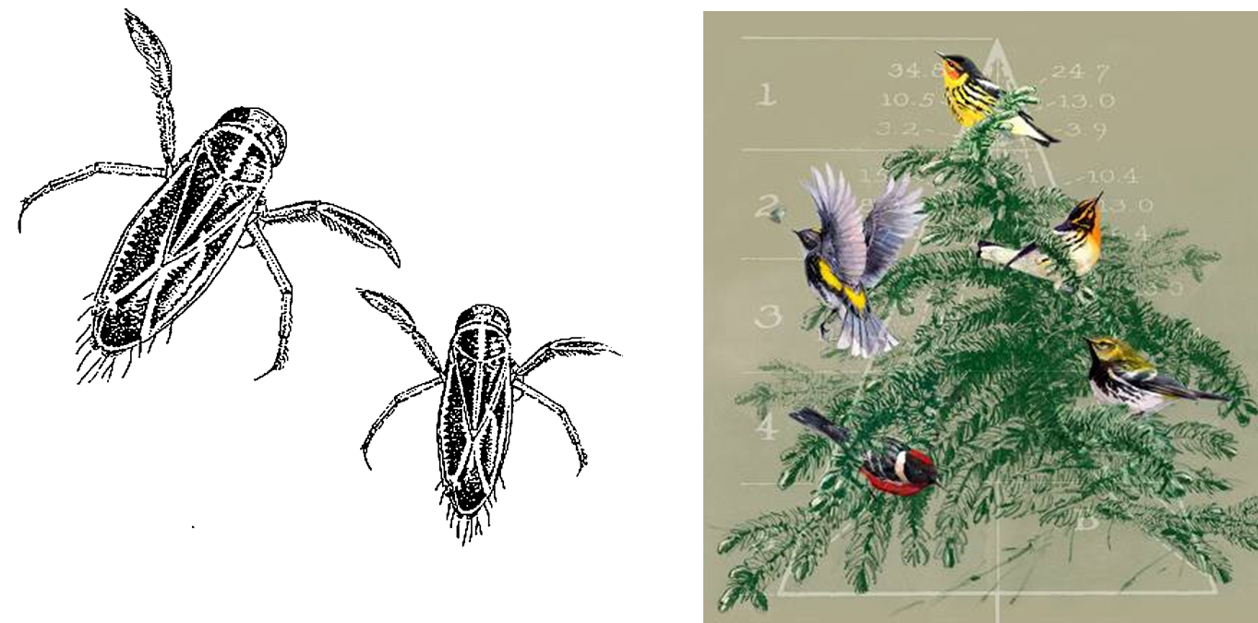
Even classic coexistence stories had a spatial component

Slide 18

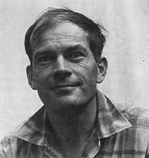
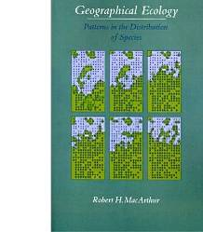
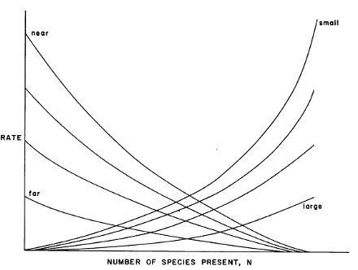
“MacArthur’s Paradox” and the Metacommunity
Local perspective
Regional perspective
Original Resource Ratio Model
Basis for Niche Theory
Theory of Island Biogeography:
Basis for Neutral Theory

Slide 19
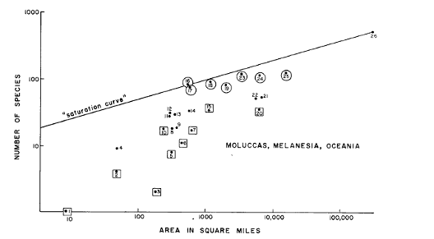
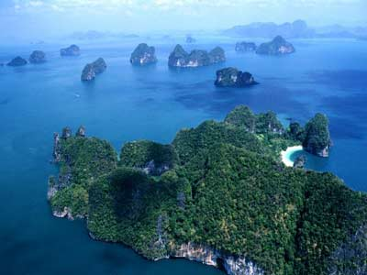
The role of space…
MacArthur and Wilson 1963

Slide 20
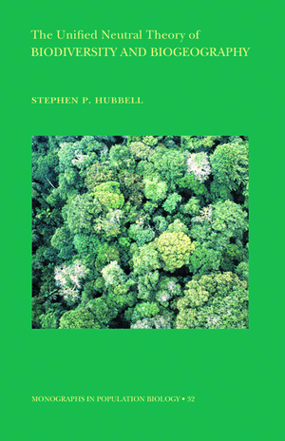
Unified Neutral Theory:
A successful, if not simplistic, metacommunity theory
Are species everywhere they could be?
What regulates species commonness and rarity?
Are communities stable or ever-changing through time?
The ‘Neutral Theory’ provided an alternative framework to more traditional ‘Niche Theory’ that appeared to predict a number of commonly observed patterns in nature

Slide 21
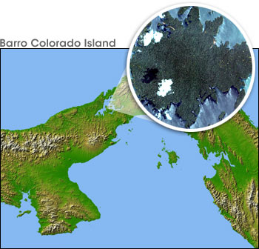
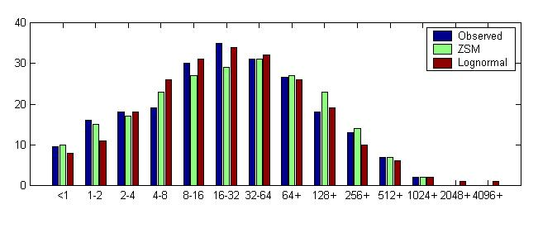
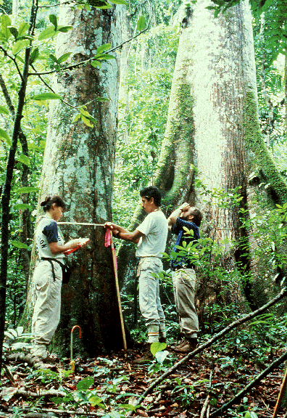
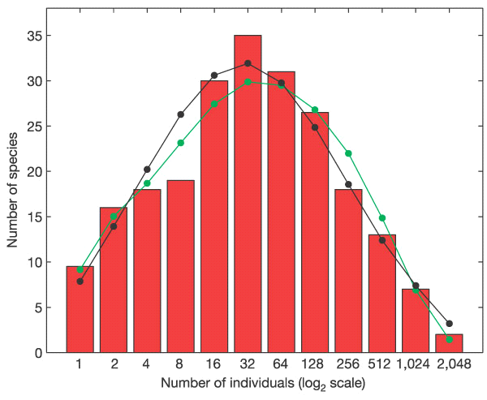
Tests with Species Abundance Distributions (SADs)
Initial tests of neutral theory
50 ha on Barro Colorado Island
McGill 2003, Nature
ZSM
Lognormal
Volkov et al. 2004, Nature

Slide 22
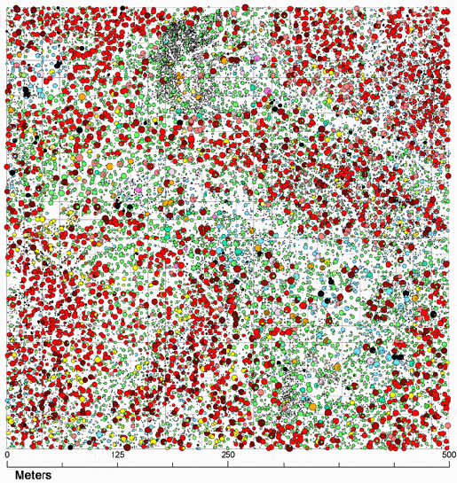
What influences spatial aggregation? How do we quantify it?

Slide 23
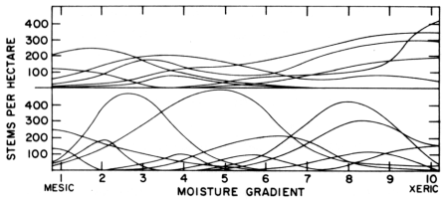
Whittaker’s concept of β-diversity
Low β-diversity
Siskiyou Mountains, Oregon
Santa Catalina Mountains, Arizona
High β-diversity
A deterministic “niche-based” perspective

Slide 24

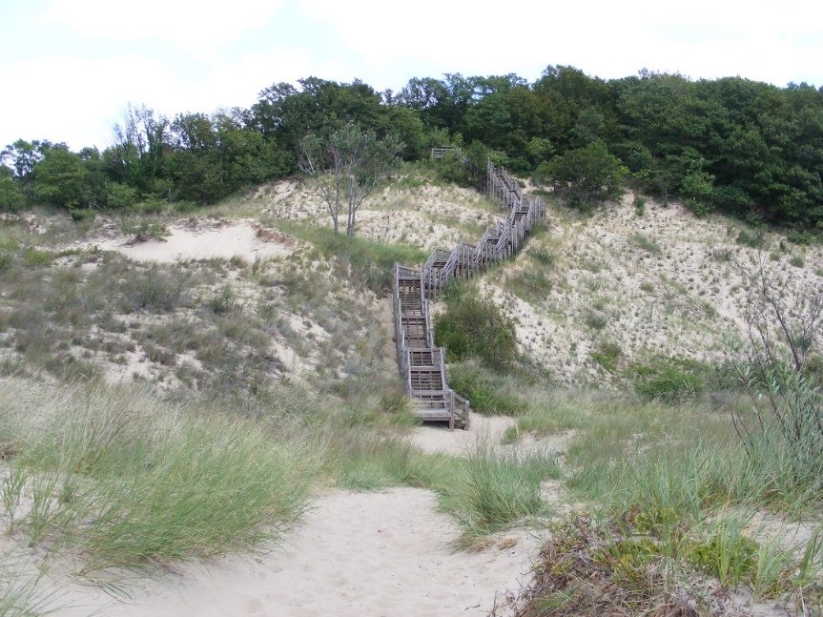
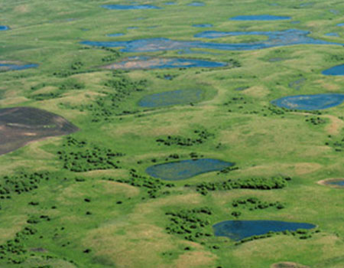

Just How Predictable are Communities?
… Tansley, Gleason, Cooper, Egler, others
"The vegetation of an area is merely the resultant of …the fluctuating and fortuitous immigration of plants and an equally fluctuating and variable environment”
…Clements, Phillips, others
Climax communities and super-organisms
Gleason 1926

Slide 25
Using β-diversity to Disentangle Niche vs. Drift/Dispersal Limitation
Regional Species
Pool
β-
diversity
Species Sorting
(Niche)
A B C D
A B C D E
F G H I J
D E F G
G H I J
Regional Species
Pool
β-
diversity
A B C D
A B C D E
F G H I J
Stochastic assembly
(Drift)
D E F G
G H I J

Slide 26
Space vs. environment: What can β-diversity tell us?
Neutral Model
Niche Model
Beta-diversity
Beta-diversity
Spatial gradient
Spatial gradient
Environmental gradient
Environmental gradient
Chase et al. 2005

Slide 27
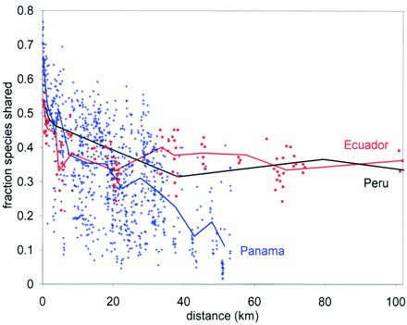
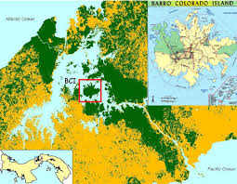
Beta diversity in tropical forests: Lots of ‘unpredictability’ (i.e., drift)
Condit et al. 2001 Science

Slide 28
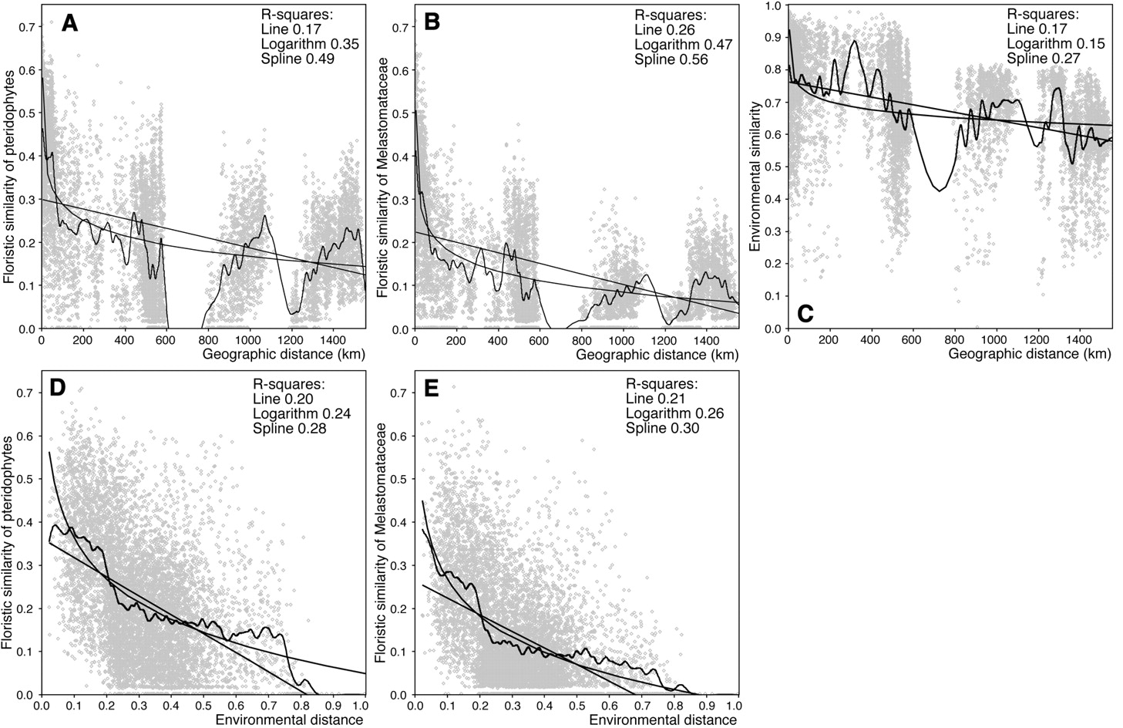
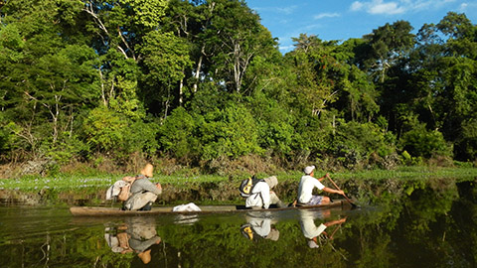


Slide 29
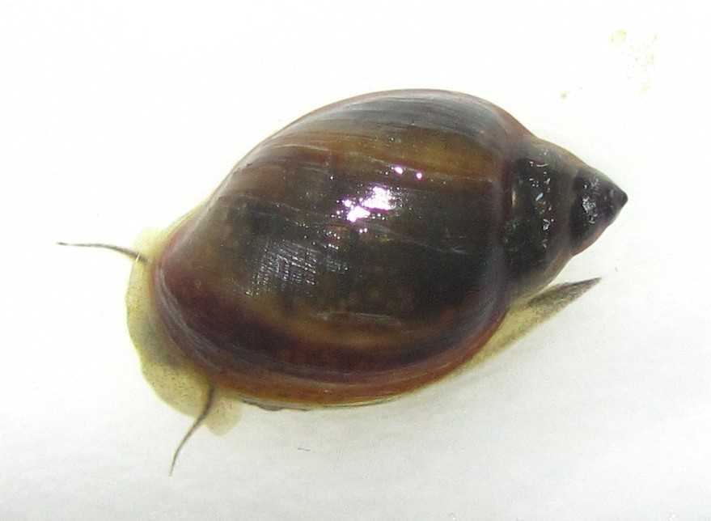
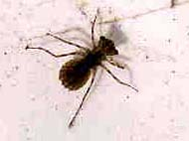
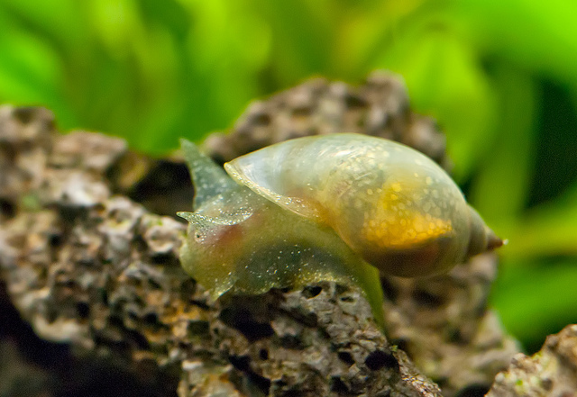
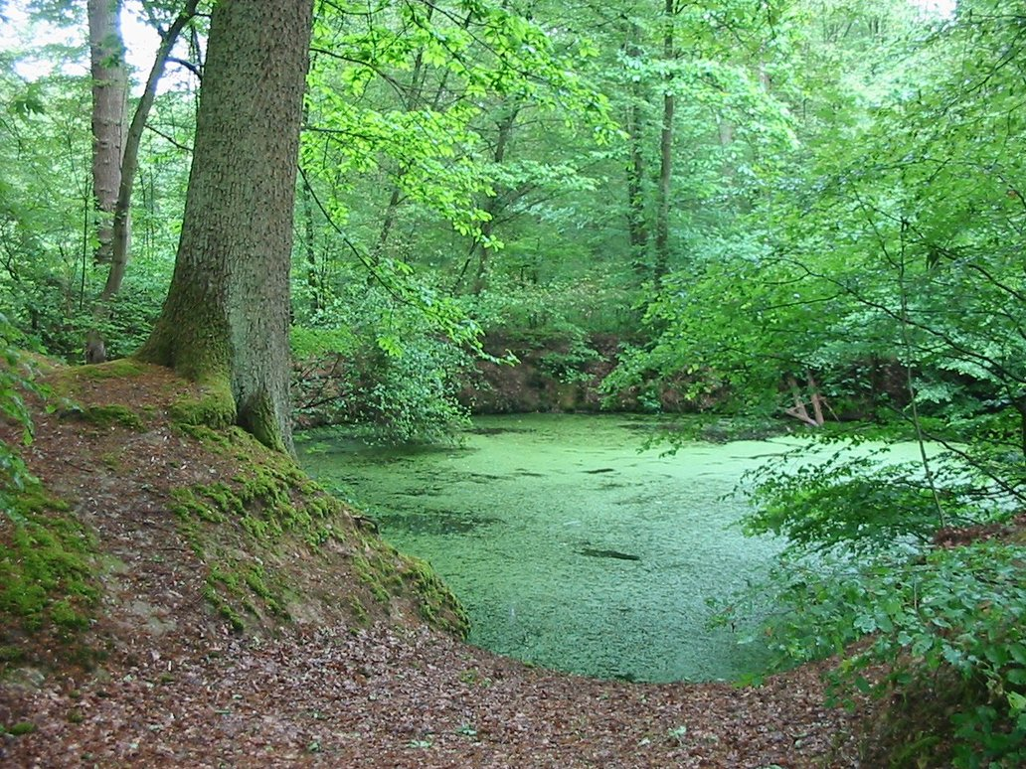
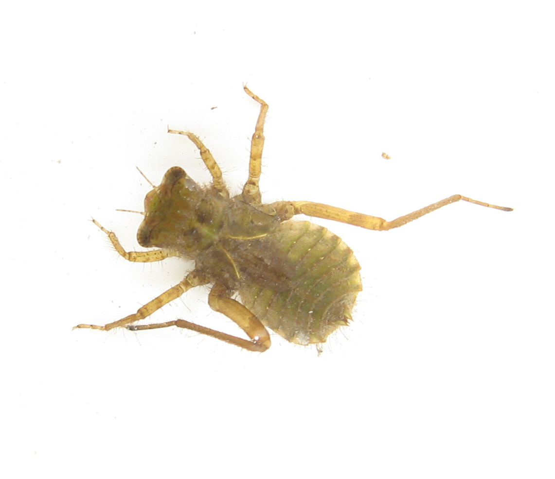
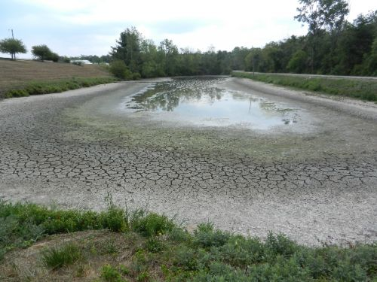
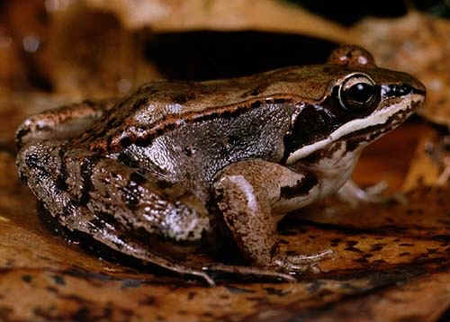
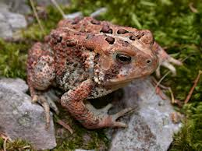
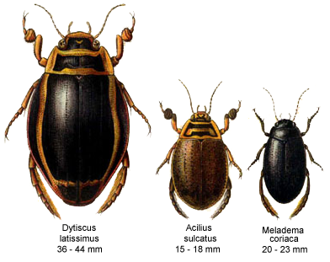
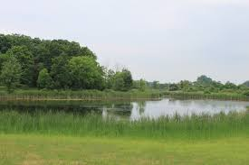
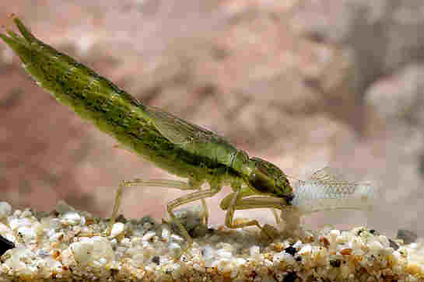
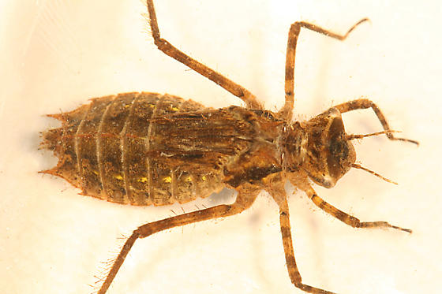
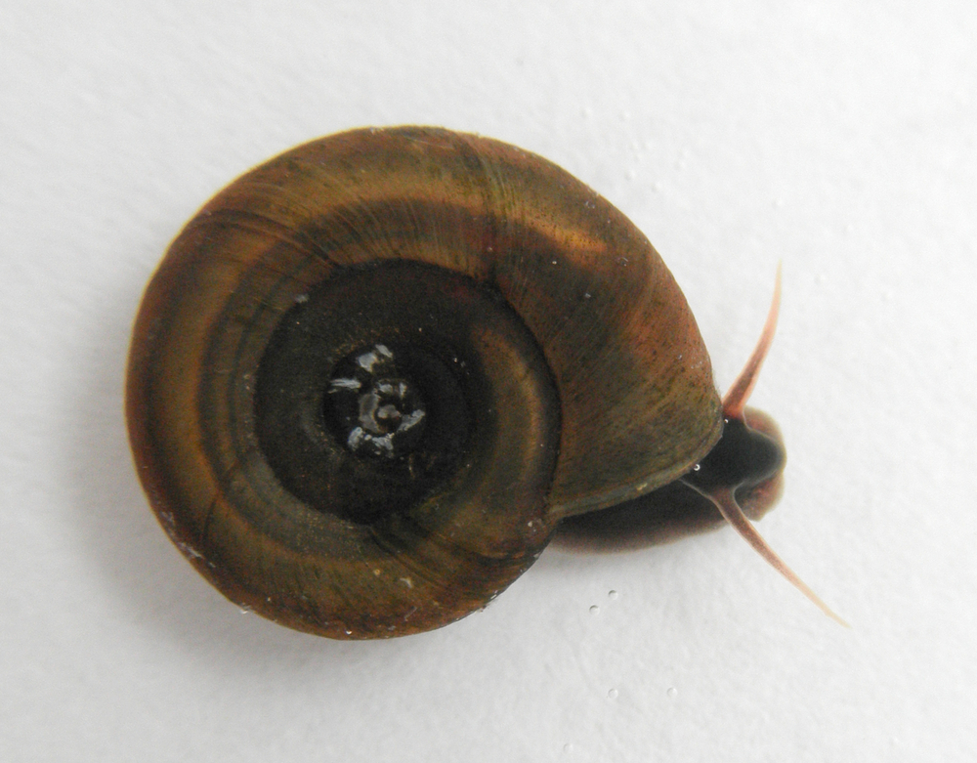
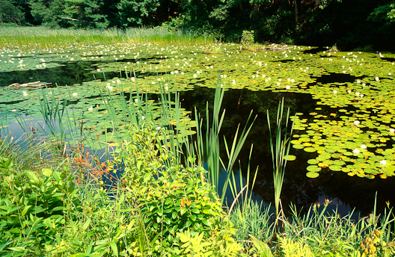
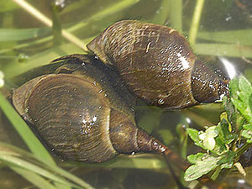
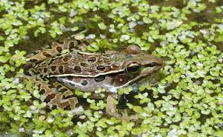


Small Freshwater Ponds—Niche Reigns Supreme

Slide 30
Small Freshwater Ponds—Niche Reigns Supreme
1
0.75
0.5
0.25
0
1
0.75
0.5
0.25
0
Compositional Similarity (Jaccard’s)
Compositional Similarity (Jaccard’s)
0 50 100 150 200 250 300 350 400 450
0 0.1 0.2 0.3 0.4 0.5 0.6 0.7 0.8 0.9 1.0
Spatial Distance (m)
Environmental Distance

Slide 31


Partitioning the variation of β-diversity
(Legendre, Borcard, Peres-Neto, et al).
β-diversity structure
Spatial/Environmental structure

Slide 32

A lot of unexplained variation—drift (?), unmeasured?
‘Unexplained variation’
Leibold and Chase 2017

Slide 33


Patterns on BCI and Small Ponds are at the extremes
….But are they structured by different processes??
Environment (≈ niche)
BCI
Space (≈ dispersal)
Michigan Ponds
Residuals (≈ drift + unmeasured)
Cottenie 2005, Ecol. Lett
Leibold & Chase 2017

